Slide 1

BANK LOAN
CASE STUDY
PROJECT
By Yugashini. S

Slide 2
PROJECT DESCRIPTION
The goal of this project is to analyze loan application data to identify patterns in customer behavior and loan default risks. Using Exploratory Data Analysis (EDA), the focus is on understanding key factors that influence loan approval and repayment.This analysis helps ensure that capable applicants are not rejected while minimizing financial losses from defaults. By examining customer attributes and loan details, the project aims to support data-driven lending decisions, such as approving,rejecting, or adjusting loan terms based on risk levels.
APPROACH
The dataset was explored and cleaned in Excel, handling missing values and formatting for analysis. Descriptive statistics and pivot tables were used to summarize loan trends. EDA was performed through univariate, bivariate, and segmented analysis to identify key risk factors. Charts and visualizations were created to highlight patterns in loan approvals and defaults. Finally, insights were derived to suggest better loan approval strategies, reducing financial risks while improving decision-making.

Slide 3
TECH-STACK USED
For this project, I utilized Microsoft Excel 2021 for data analysis, statistical calculations, and visualization using various charts and pivot tables.
INSIGHTS
We will explore the insights gained from this analysis below.
A.Identify Missing Data and Deal with it Appropriately
To identify the missing data in the dataset and decide on an appropriate method to deal with it using Excel built-in functions and features.

Slide 4
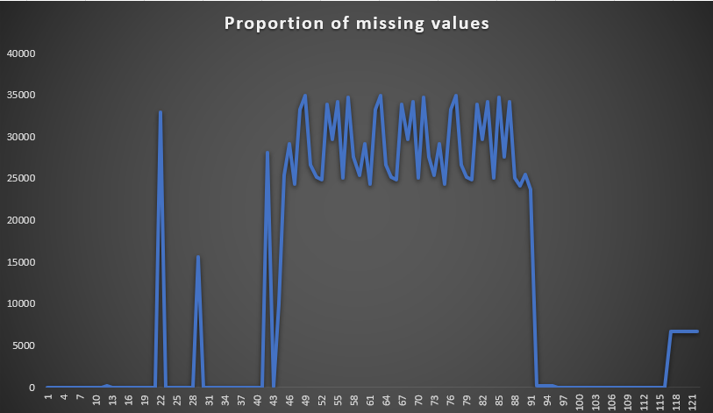
For handling missing data, I utilized the COUNTBLANK function in Excel to identify null or blank values across each column.
Columns with more than 30% missing data (out of 50,000 rows) were removed to maintain data integrity. For the remaining missing values, I replaced them with the median to preserve data consistency.
Additionally, I created a visualization to analyze the distribution of missing values, ensuring a clearer understanding of data gaps.
This line chart represents the Proportion missing values in each column.
Formula used : COUNTBLANK()

Slide 5
B. Identify Outliers in the Dataset
Outliers can significantly impact the analysis and distort the results. You need to identify outliers in the loan application dataset.To detect and identify outliers in the dataset using Excel statistical functions and features, focusing on numerical variables.
I used the quartile function to calculate the interquartile range (IQR) and determined the lower and upper bounds to identify outliers. Any values below the lower bound or above the upper bound were considered outliers.
To highlight them, I applied conditional formatting for better visibility. Instead of removing them,I chose to retain the outliers, as they might be relevant for analysis.
Additionally, I created scatter plots and box plots to visualize their distribution and impact on the dataset.
Formula used :
Quartile(Q1)=QUARTILE(range,1)
Quartile(Q3) =QUARTILE(range,3)
Interquartile Range (IQR) = Q3 - Q1
Lower Bound = Q1 - 1.5 * IQR
Upper Bound = Q3 + 1.5 * IQR

Slide 6
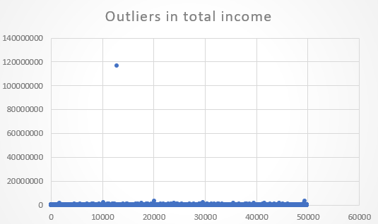
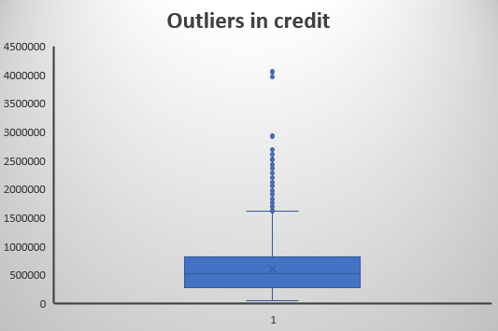
Visualizations of Outliers

Slide 7
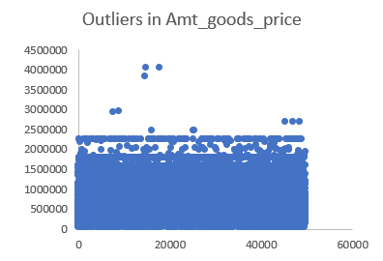
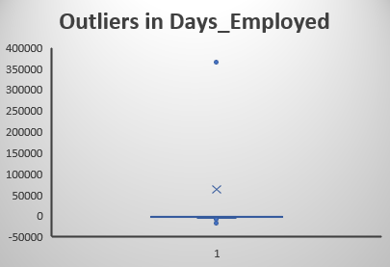
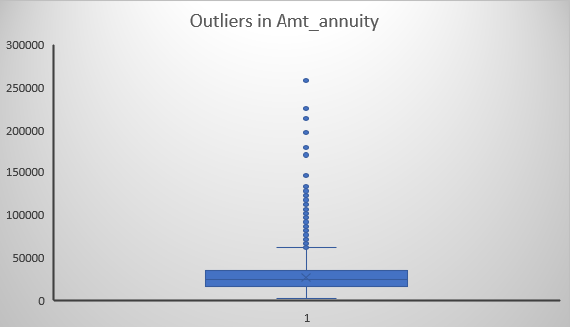

Slide 8
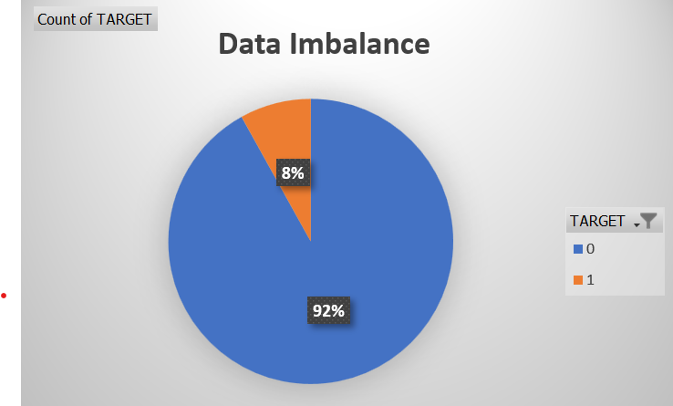
C. Analyze Data Imbalance
Data imbalance can affect the accuracy of the analysis, especially for binary classification problems. Understanding the data distribution is crucial for building reliable models.
Task: Determine if there is data imbalance in the loan application dataset and calculate the ratio of data imbalance using Excel functions.
To identify data imbalance, I created a Pivot Table for the target variable to calculate its distribution. The analysis of the target variable reveals a significant class imbalance, with 92% of the data belonging to class 0 (non-defaulters) and only 8% belonging to class 1 (defaulters).
Then, I used a Pie Chart to visually represent the proportion
of each class, making it easier to spot any significant
class imbalances.
This imbalance indicates that the dataset is highly skewed toward a particular category(Non-Defaulters), which may lead to biased model predictions favoring the majority class.

Slide 9
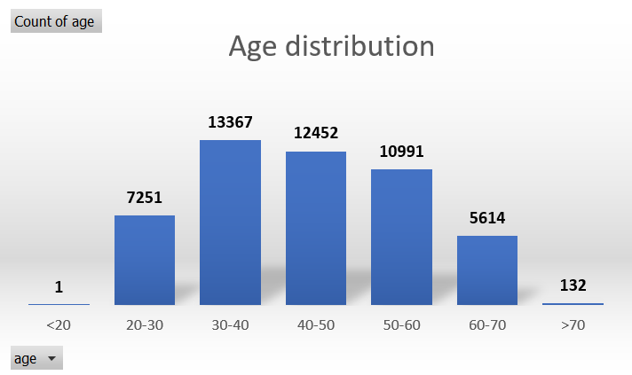
D. Perform Univariate, Segmented Univariate, and Bivariate Analysis
Task : To Perform univariate analysis to understand the distribution of individual variables, segmented univariate analysis to compare variable distributions for different scenarios, and bivariate analysis to explore relationships between variables and the target variable using Excel functions and features.
Univariate Analysis
I performed univariate analysis to understand the distribution of key attributes like age, income, family status, education level, and number of children with help of count function.
This helped in identifying patterns and trends among loan applicants, which can aid in better risk assessment and decision-making.

Slide 10
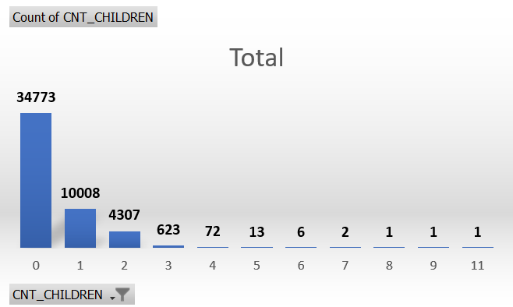
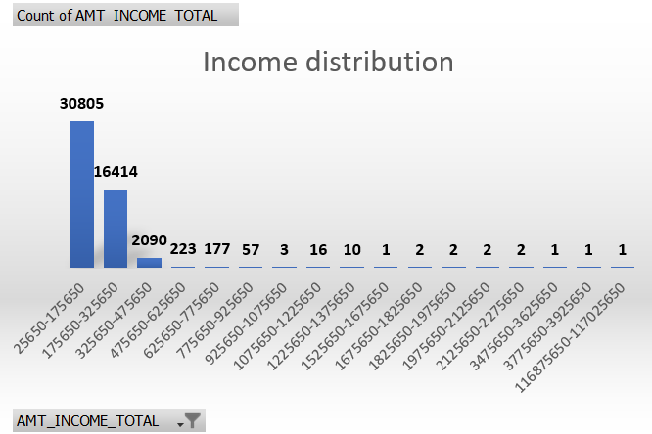
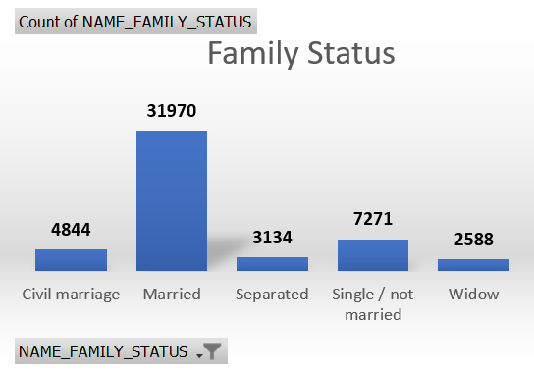
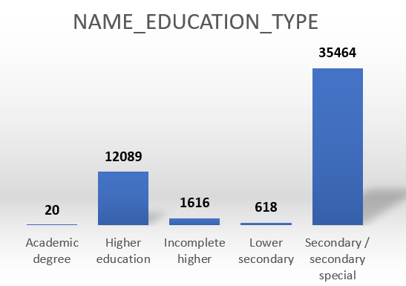

Slide 11
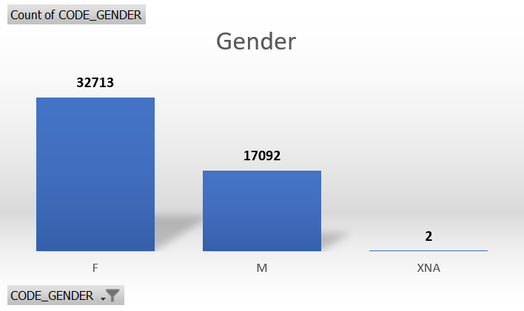
Insights from univariate analysis
Majority of applicants are middle-aged, married, and have secondary education.
Most have low to mid-range incomes, with very few earning high salaries.
A small portion of applicants have multiple children, which could indicate potential financial strain.
Segmented Analysis
Segmented analysis involves dividing data into meaningful groups based on specific attributes, such as gender, income type, or education level.
This helps in identifying patterns, trends, and differences within each segment, enabling better decision-making and targeted strategies.
I used Pivot Tables to categorize data, along with functions like COUNT, SUM, and AVERAGE for summarization.

Slide 12
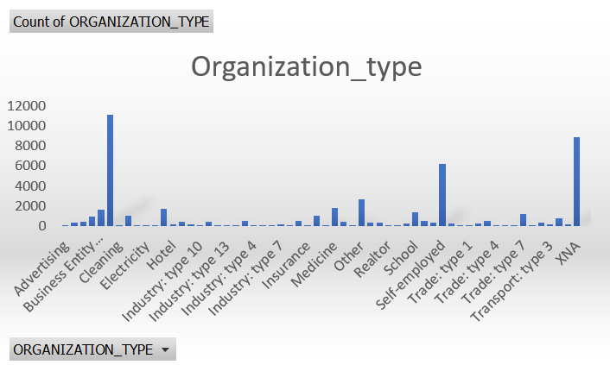
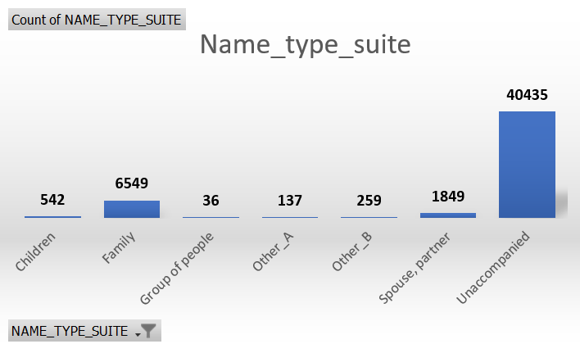
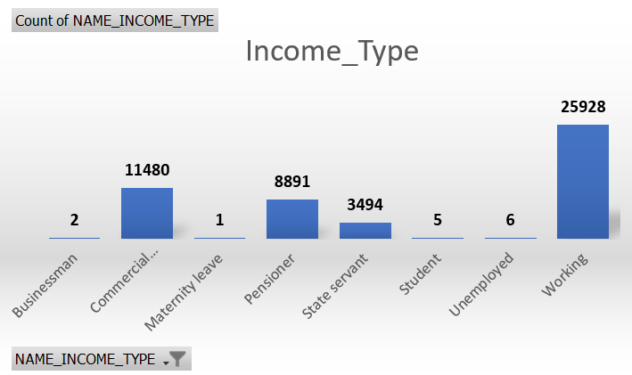
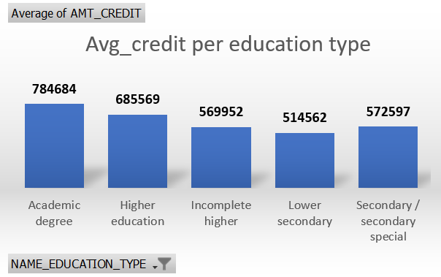

Slide 13
Insights from Segmented Analysis
Gender : The majority of applicants are female.
Organization Type : Shows the distribution of applicants based on their industry of employment, with certain sectors (Business entity type 3, Self employed, XNA having a higher number of applicants.
Name Type Suite : Indicates the living arrangements of applicants (e.g., Unaccompanied, Family, Spouse/Partner), which could be a factor in loan approval.
Income Type : Most applicants are working professionals, followed by pensioners and state servants.
Average Credit per Education Type : Represents the average credit amount requested by applicants based on their education level, showing that those with academic degrees have the highest credit requests.

Slide 14
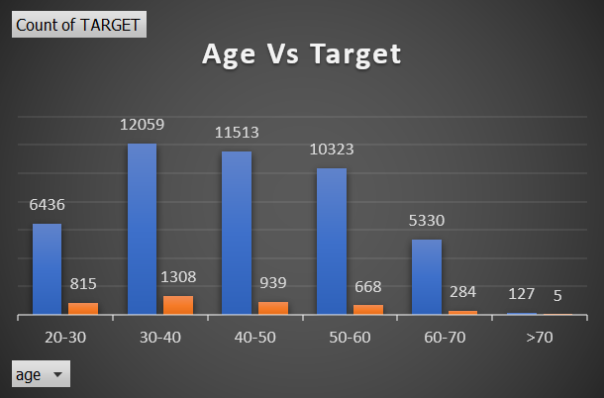
Bivariate Analysis
Bivariate analysis examines the relationship between two variables to identify patterns, dependencies, or correlations. In this case, the analysis compares loan default (TARGET) with different factors like age, income, gender, education, and family status to determine their impact on loan repayment.
The TARGET variable represents loan repayment status (e.g., 0 = non-defaulter, 1 = defaulter).
I analyzed other variables such as Age, Income, Gender, Education, and Family Status against
TARGET to identify patterns in loan defaults.
By using a Pivot Table, I counted occurrences of each category, allowing me to determine which groups have higher default rates.
In this chart, most loan applicants are in the 30-50 age group, with younger and older groups having fewer applicants. Default rates (orange) appear slightly higher in the 30-40 age range.

Slide 15
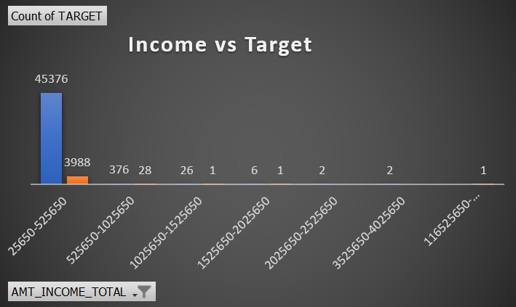
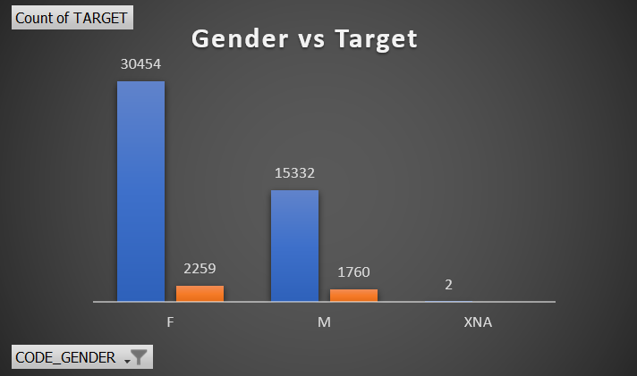
It shows lower-income groups (below 325,580) have the highest number of applicants and defaults. Higher-income groups have significantly fewer applicants and defaults.
Here, the bar chart depicts more female applicants than male, but both have some loan defaults.

Slide 16
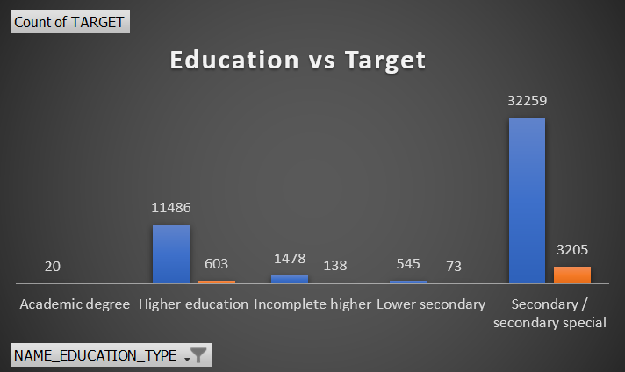
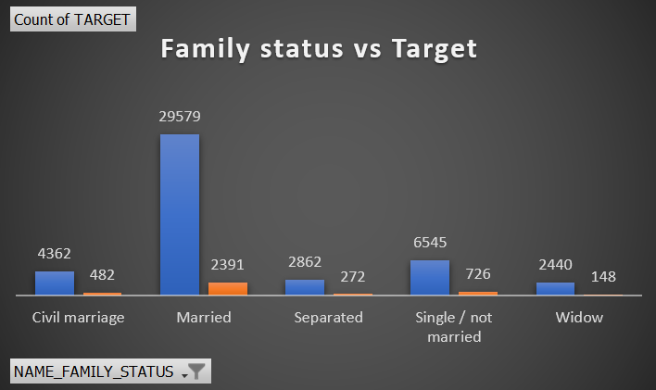
Applicants with secondary education dominate, but they also have the highest default rate. Higher education levels have fewer defaults.
Married applicants are the majority, but single/not married and civil marriage categories also show notable defaults.

Slide 17
E. Identify Top Correlations for Different Scenarios
Understanding the correlation between variables and the target variable can provide insights into strong indicators of loan default.
Task: Segment the dataset based on different scenarios (e.g., clients with payment difficulties and all other cases) and identify the top correlations for each segmented data using Excel functions.
I calculated the correlation coefficient to analyze the relationship between various factors (age, income, education, etc.) and loan default (TARGET variable).
I segmented the dataset by filtering the TARGET variable into defaulters (1) and non-defaulters (0) in separate sheet.
Then, I used the CORREL function in Excel to calculate the correlation between independent variables (e.g., income, age) and loan default.
Finally, I analyzed and ranked the correlation values to identify key factors affecting loan defaults, using color scales in conditional formatting.
A strong positive correlation means an increase in one variable increases the likelihood of default, while a negative correlation is the opposite.

Slide 18
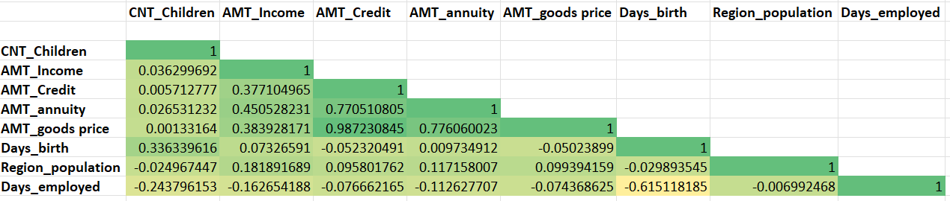
Correlations for Non-defaulters
Top Positive Correlations
AMT_Credit and AMT_goods price (0.987)
AMT_Credit and AMT_annuity (0.7705)
AMT_annuity and AMT_goods price (0.776)
AMT_Income and AMT_annuity (0.4505)

Slide 19
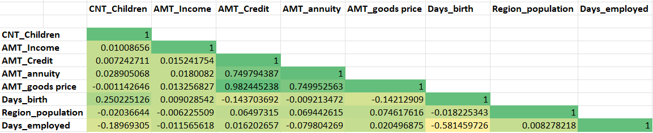
Correlations for Defaulters (Applicants with payment difficulty)
Top Positive Correlations
AMT_goods price & AMT_Credit (0.982)
AMT_annuity & AMT_Credit (0.749)
AMT_annuity & AMT_goods price (0.749)

Slide 20
Result
This bank loan case study provided valuable insights into the factors influencing loan defaults, helping financial institutions make data-driven lending decisions.
By analyzing demographic and financial attributes, the study identified high-risk borrower groups, emphasizing the importance of income stability, education, and age in loan repayment behavior.
Useful insights we get through this project includes,
-> Prioritize financially stable applicants by considering income and job stability. -> Use education level as a risk factor, as higher education correlates with responsible borrowing. -> Monitor younger and lower-income applicants more closely to mitigate potential risks.
Through EDA, I learned to analyze patterns, detect correlations, and segment high-risk borrowers using statistics, Excel, and data visualization. This hands-on experience strengthened my skills in real-world data analytics
Hyperlink of the result dataset
https://docs.google.com/spreadsheets/d/1pfca6H7n-HwTmVV0s5mOG-zUKfrpiO6x/edit?usp=sharing&ouid=114293071387875296860&rtpof=true&sd=true

